Slide 1
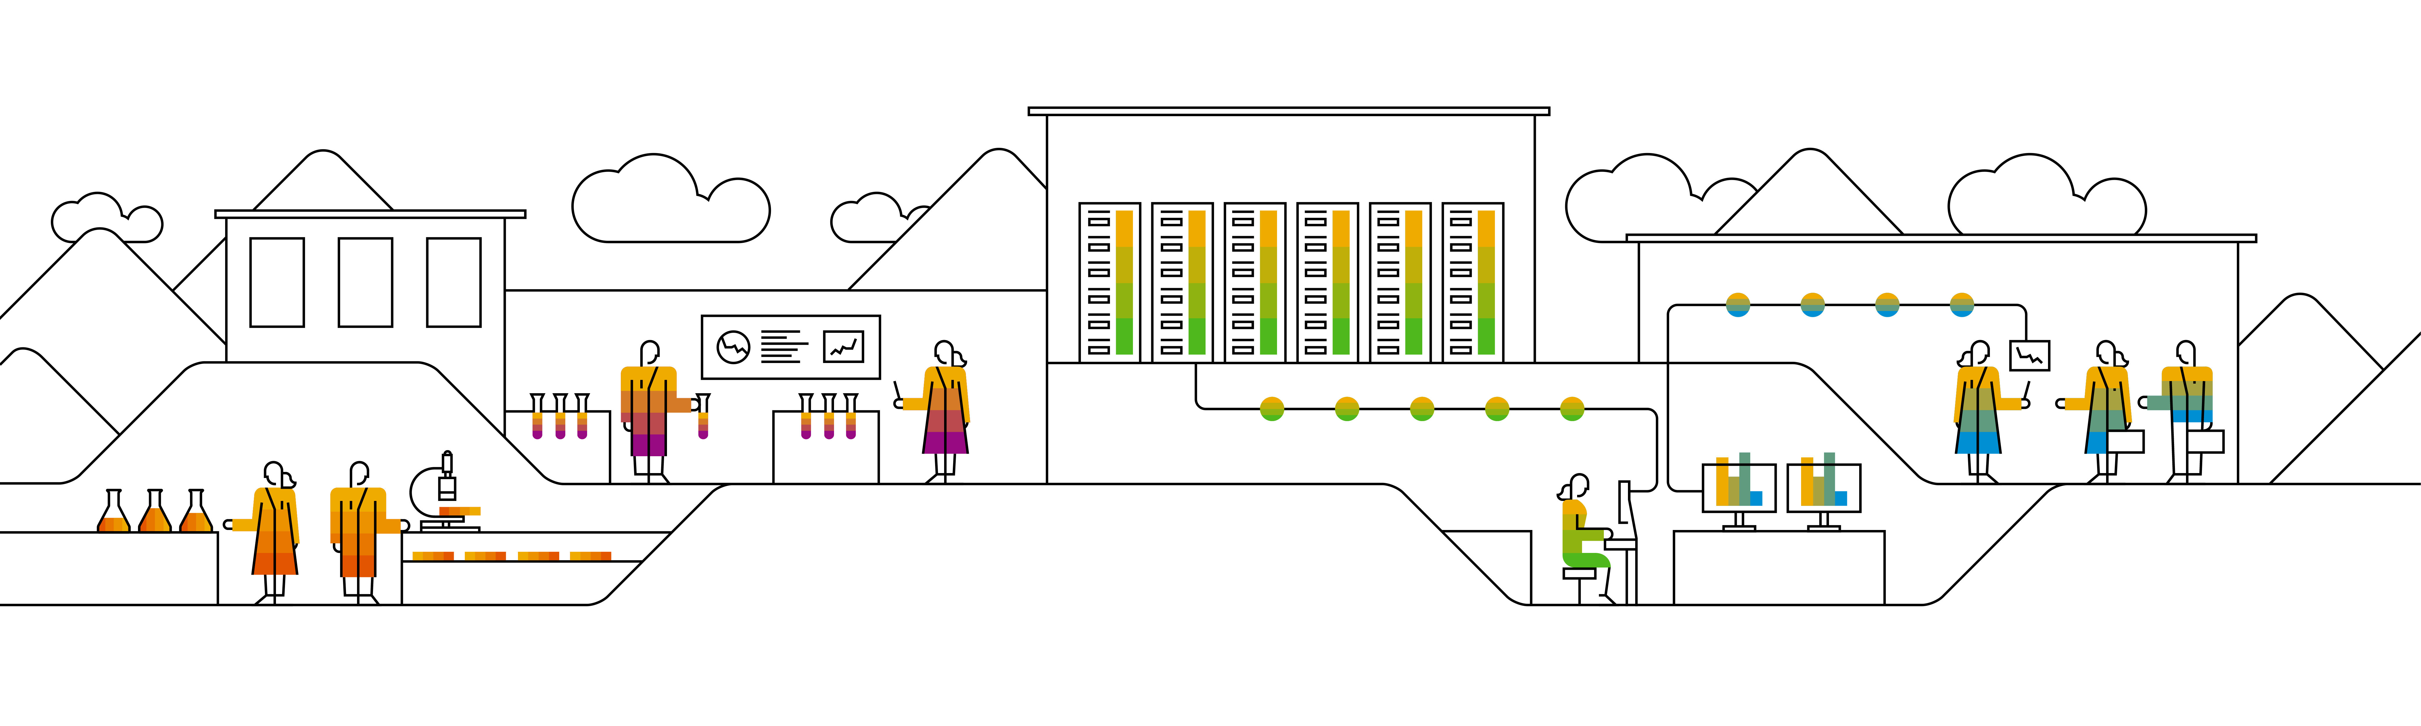
Unsupervised Learning Clustering

Slide 2
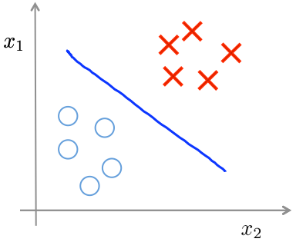
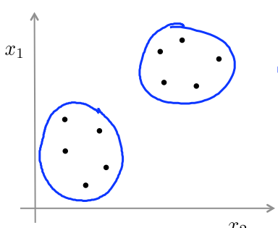
Supervised learning
Unsupervised learning

Slide 3
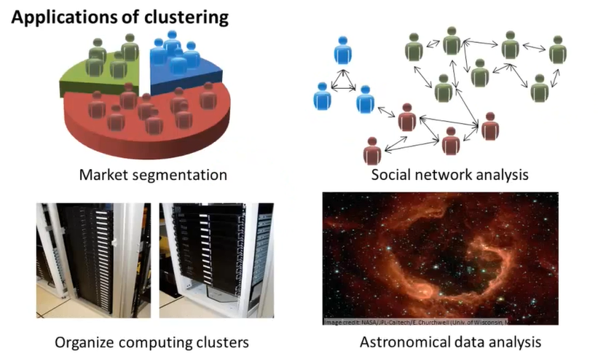
Applications of Clustering

Slide 4
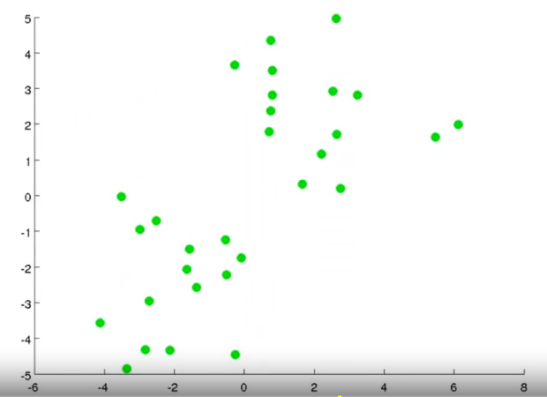
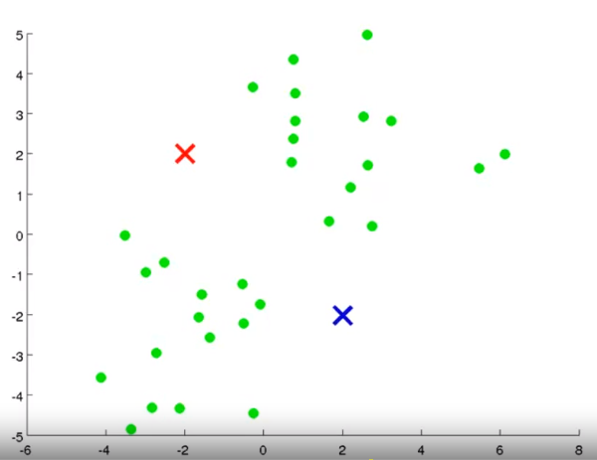
Objective Take an unlabeled dataset and group the data into clusters. Randomly assign two points, called the cluster centroids.

Slide 5
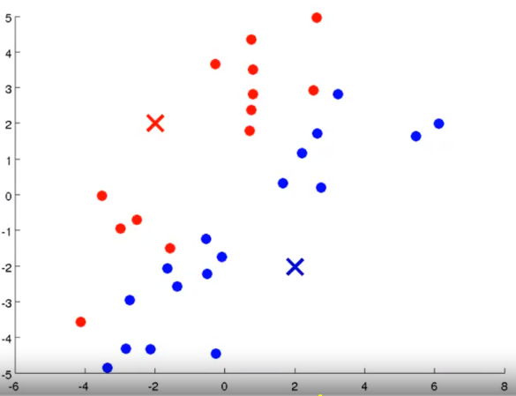
Step 1: Cluster assignment Go through the data and color each of the point either red or blue, depending on whether it is closer to the red cluster centroid or the blue cluster centroid.

Slide 6
Step 2: Move centroid Compute the mean of the red and blue points and move the respective clusters to the point.

Slide 7
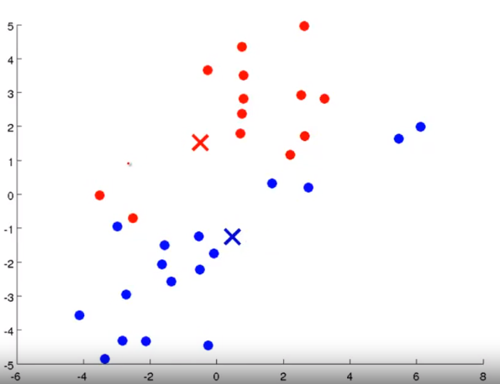
Repeat Step 1

Slide 8
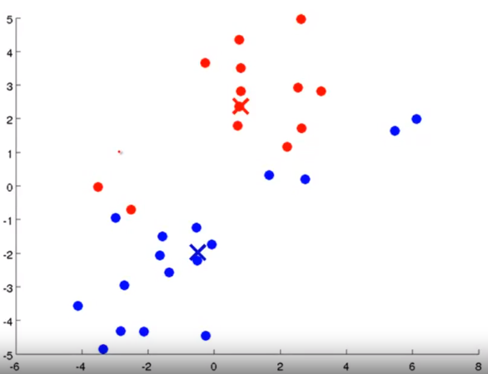
Repeat Step 2

Slide 9
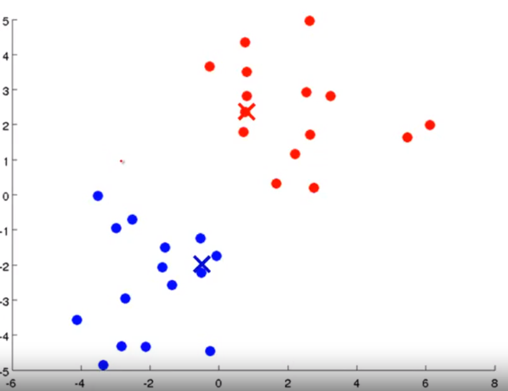
Repeat Step 1

Slide 10
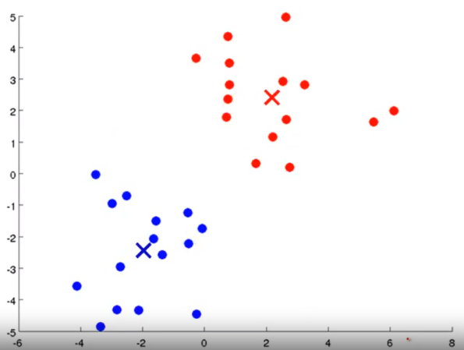
Repeat Step 2

Slide 11
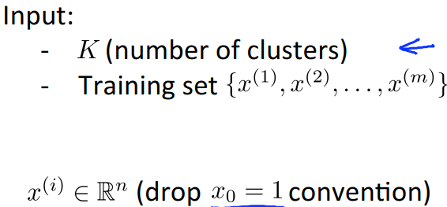

K-means algorithm

Slide 12
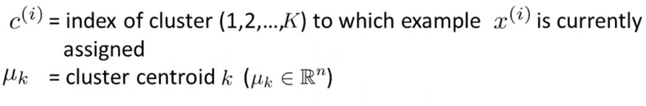
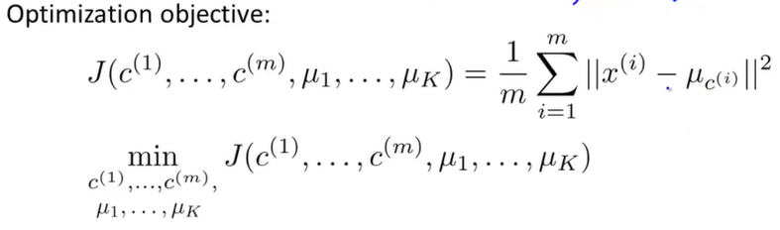
K-Means optimization objective

Slide 13
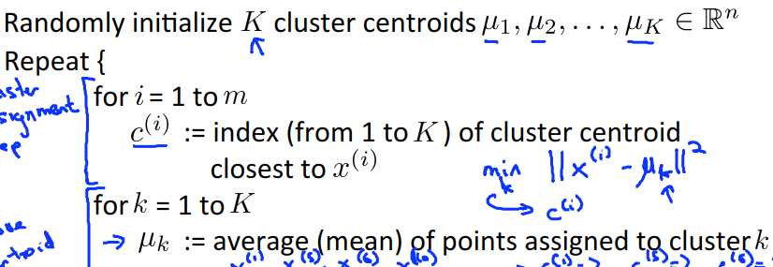





K-means algorithm
}

Slide 14
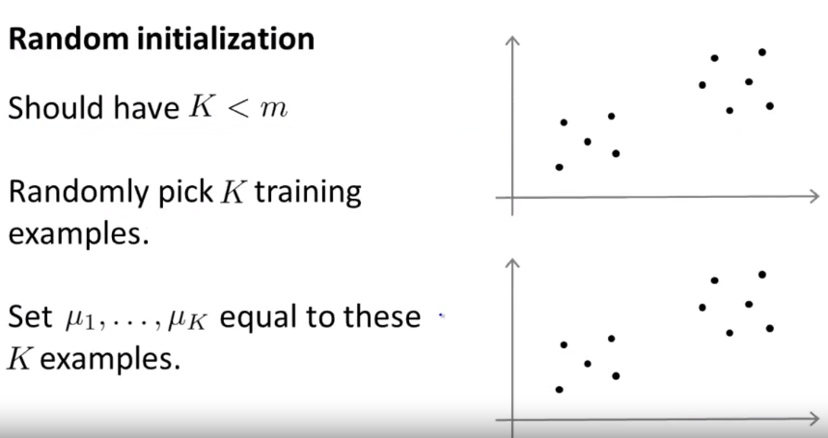
Random Initialization

Slide 15
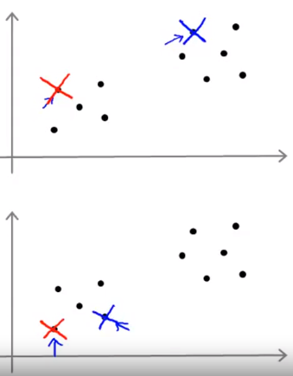
Random Initialization Example

Slide 16
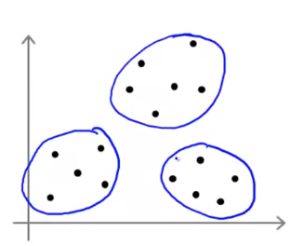
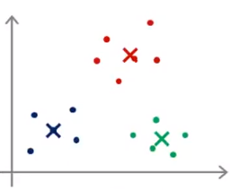
Local optima

Slide 17
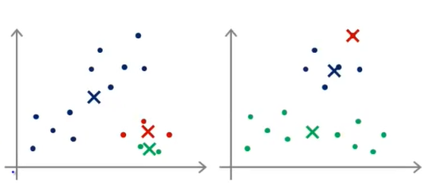

Slide 18
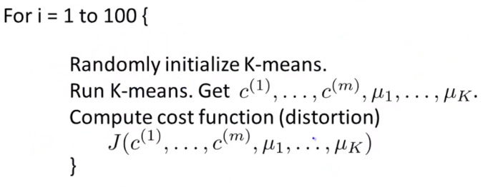
Random Initialization

Slide 19
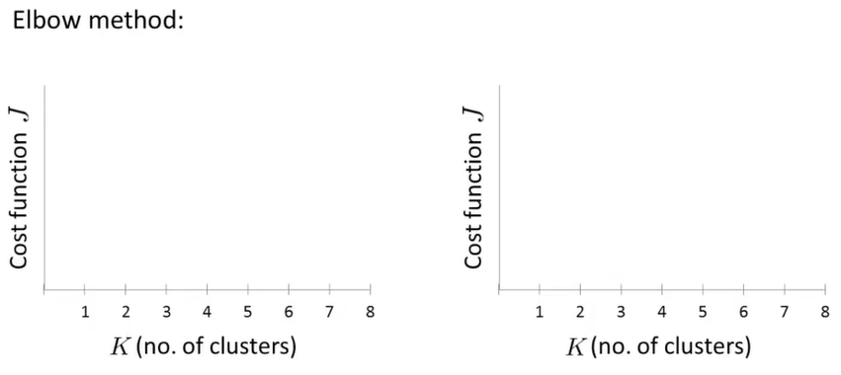
Choosing the value of K

Slide 20
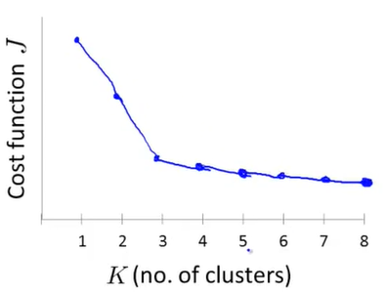
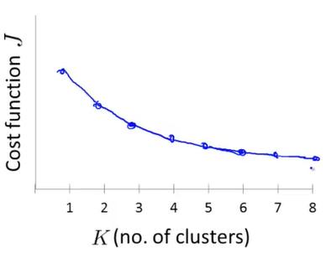

Slide 21
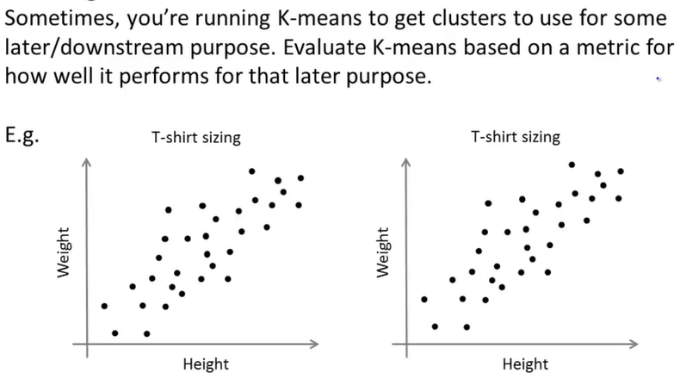
Choosing the number of K

Slide 22
Thank you.

